Slide 1
Class of 1978 Project
For our 50th Reunion
In Fall of 2028
Town Hall
October 9, 2024

Slide 2
GROUNDRULES
Meeting will be recorded and link shared with class
Everyone should remain on mute during the presentation portion of the town hall
Gift Committee members can unmute at will to add comments during the presentation portion
During the questions and comments portion, all participants should use the Raise Hand icon and unmute when recognized by the moderator
Moderator will wrap up the meeting after one hour unless participants desire to extend the discussion

Slide 3
AGENDA
Presentation about the Gift Committee’s concept for our class project for the 50th Reunion
Guidance on how classmates can make a pledge to support the 50th Reunion Class Project
Response to Questions & Comments
4. Closing

Slide 4
CLASSMATES ON THE GIFT COMMITTEE
Iain Anderson
Bruce Black
Chris Bond – chair
Manson Brown
Pepe Castillo
Bryon Ing
Mike Lucia
Mike Vincenty
Kerry Watterson
Brooke Winter

Slide 5
GIFT CONCEPT – BOTTOM LINE UP FRONT
An endowment of $780,000 to fund an Annual Class of 1978 Captain Michael A Healy Award
Funds generated through class pledge payments. Endowment generates earnings from investments to support an annual award or multiple annual awards
Selection of award recipient(s) based on three characteristics displayed by Captain Healy during his career: character, resilience, and innovation
Award intended to be flexible. Funds can be awarded to cadet project teams or individuals for project expenses, field trips, or guest speakers.

Slide 6
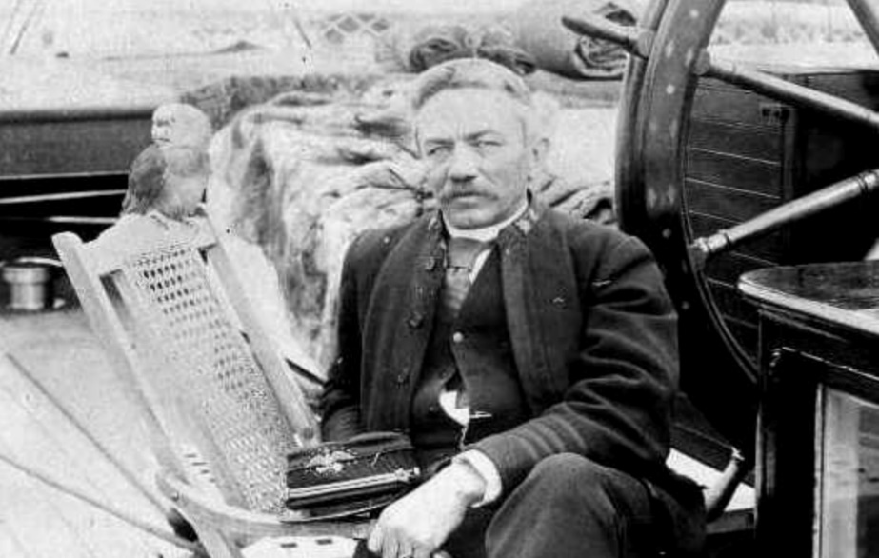
CAPTAIN MICHAEL A. HEALY
Statues at CGA do not include any officer of the Coast Guard or its predecessor services
Our class displayed exceptional character, resilience, and innovation at CGA and afterwards
Michael A. Healy is renowned for displaying these same attributes

Slide 7
PROCESS FOR GIFT SELECTION
Selection Criteria: Enduring, Inspiring, Cadet-Impactful, Feasible, Unique, and Distinctive
Initial ideas ranged from a statue of Michael Healy to endowments targeting various cadet needs. Committee engaged classmates at 45th reunion and through informal discussions to collect feedback
Various concepts were scored using a decision matrix. Committee devised the final concept by bundling together the best of various concepts.
After months of spirited debate, the Committee was unanimous in selecting the final concept.

Slide 8
EXAMPLE OF HOW AN ANNUAL AWARD CAN OCCUR
Our class establishes a small Annual Award Committee. They target one specific criteria for that year, for example Innovation.
They engage Academy faculty who manage Capstone Projects required for all First Class cadets.
Faculty assist Capstone Project cadet leaders in submitting proposals for our annual award.
The committee, working with faculty, selects one or more proposals for funding. A large check and engraved silver cups are presented in front of the entire corps of cadets. Actual distribution of funds is performed by the Alumni Association.

Slide 9
TIMELINE
Present – Conduct a campaign to raise $780,000 from our class in cash donations and pledges
Present – End of 2028 Complete payment of all
pledges from classmates
Fall 2028 Present our gift to CGA at our 50th reunion
Winter 2028 Execute the first award
process and make the actual
award to first class cadets
Early 2029 Cadets use funds to complete
projects before graduation

Slide 10
PLEDGE PROCESS FOR CLASS 50th GIFT
CGAAA is managing our Class 50th Endowment
50th Endowment - in addition to the financial target, our goal is to get 100% classmate participation.
Options to donate:
One Time Donation
Pledge over time, amount to be completed by December 2028 (pledge of the amount above to be paid over a period of years)
Click for Letter of Intent (LOI)
Fill out form and indicate method to donate and total at completion
Print out LOI, sign it and email a PDF copy to Susan Kenyon

Slide 11
PLEDGE PROCESS FOR CLASS 50th GIFT
For those still employed, seek out corporate matching for your donations
Consider other funding sources per the LOI page
Any website donation questions CGAAA POC: Susan Kenyon (860) 442-2683 x12 (skenyon@cgaalumni.org)
Direct Endowment Web Link: CGAalumni.org/1978gift
Display the Web Link

Slide 12
COMMENTS FROM OTHER COMMITTEE MEMBERS
REVIEW CHAT QUESTIONS & COMMENTS
Just a reminder to please raise your hand if you have a question or comment. I’ll recognize you and ask my fellow committee members to help out if I miss anyone.
If you are unable to comment on your device, please contact any one of the committee members: Iain Anderson, Bruce Black, Chris Bond, Manson Brown, Pepe Castillo, Bryon Ing, Mike Lucia, Mike Vincenty, Kerry Watterson, Brooke Winter
Notes:
Thanks, Bryon
I’d like to call on my fellow committee members to add any comments. I’ll call on our chair, Chris Bond, at the end.
Now it’s time for your questions and comments. Please raise your hand so I can recognize you. (Time Check)

Slide 13
CLOSING
Look for updates at uscga78.org

